Slide 1
Data Mining Cup 2017 Revenue Forecast of Mail Order Pharmacy
1st intermediate presentation
Data and Web Science Group
University of Mannheim
Daniel Helfer, Timo Sturm, Alexander Brinkmann, Steffen Terheide, Florian X, Nancy X, Liane X, Christoph Wagner
25.04.2017

Slide 2
DMC 17 - Challenge
Original task
Two step model
Adjusted two step model
Predict the type of user action (Click/Basket =1 vs. Order =1)
Predict the type of user action (Click/Basket =1 vs. Order =1)
Predict the revenue for every user action
Predict the revenue for all “order” actions
Predict the quantity for all “order” actions
Regression problem
Classification problem

Slide 3

Overview
Selection
Preprocessing
Transformation
Data Mining
Evaluation & Interpretation
Available data
…….
Target
Data
Preprocessed Data
Transformed Data
Patterns
Adopted from Fayyad et al. (1996)

Slide 4
Preprocessing
Feature Understanding
Feature Generation
Selection
Preprocessing
Transformation
Data Mining
Evaluation & Interpretation
Available data
…….
Target
Data
Preprocessed Data
Transformed Data
Patterns
Adopted from Fayyad et al. (1996)

Slide 5
Feature Understanding
Feature | Data Insights | Implications
Pid | Train data 21,928 unique pids Class data 20,525 unique pids | Remove records only in the train set
…

Slide 6
Feature Generation
Goal | New Feature
Quantity of ordered products, label for the regression problem | Quantity
Indicator if actions has a revenue | hasRevenue
…

Slide 7
Data Mining and Evaluation
Time Dependent Behavior
Baseline
Performance Measurement
Selection
Preprocessing
Transformation
Data Mining
Evaluation & Interpretation
Available data
…….
Target
Data
Preprocessed Data
Transformed Data
Patterns
Adopted from Fayyad et al. (1996)

Slide 8
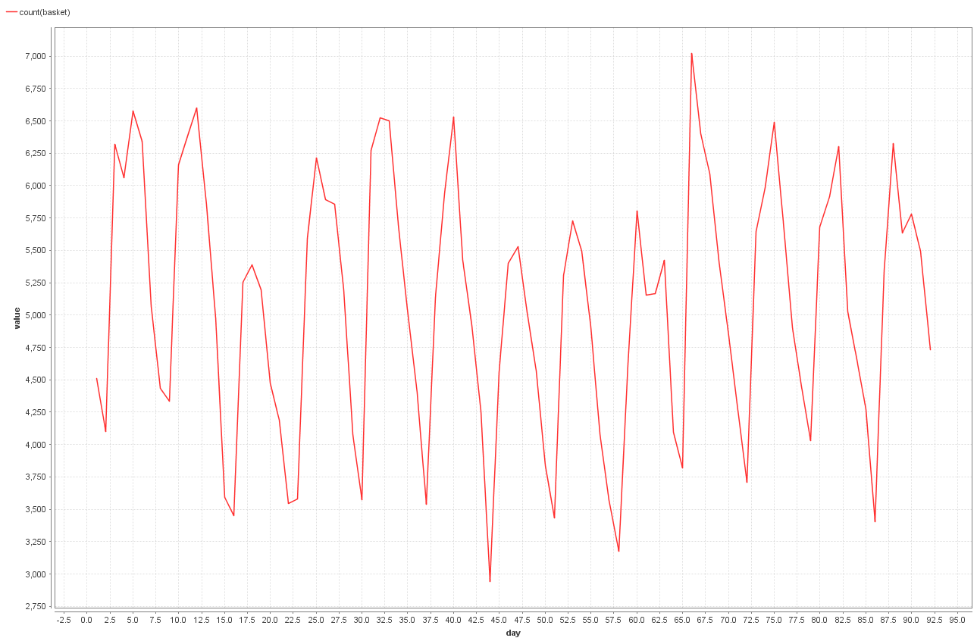
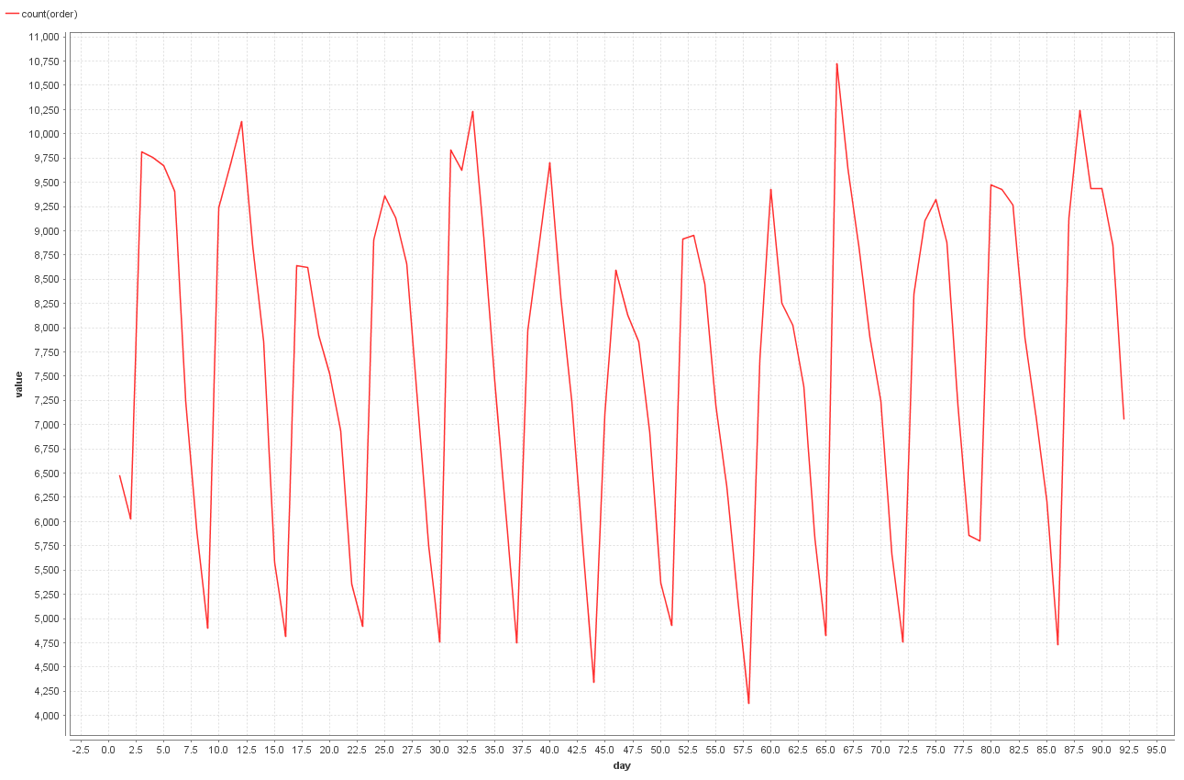
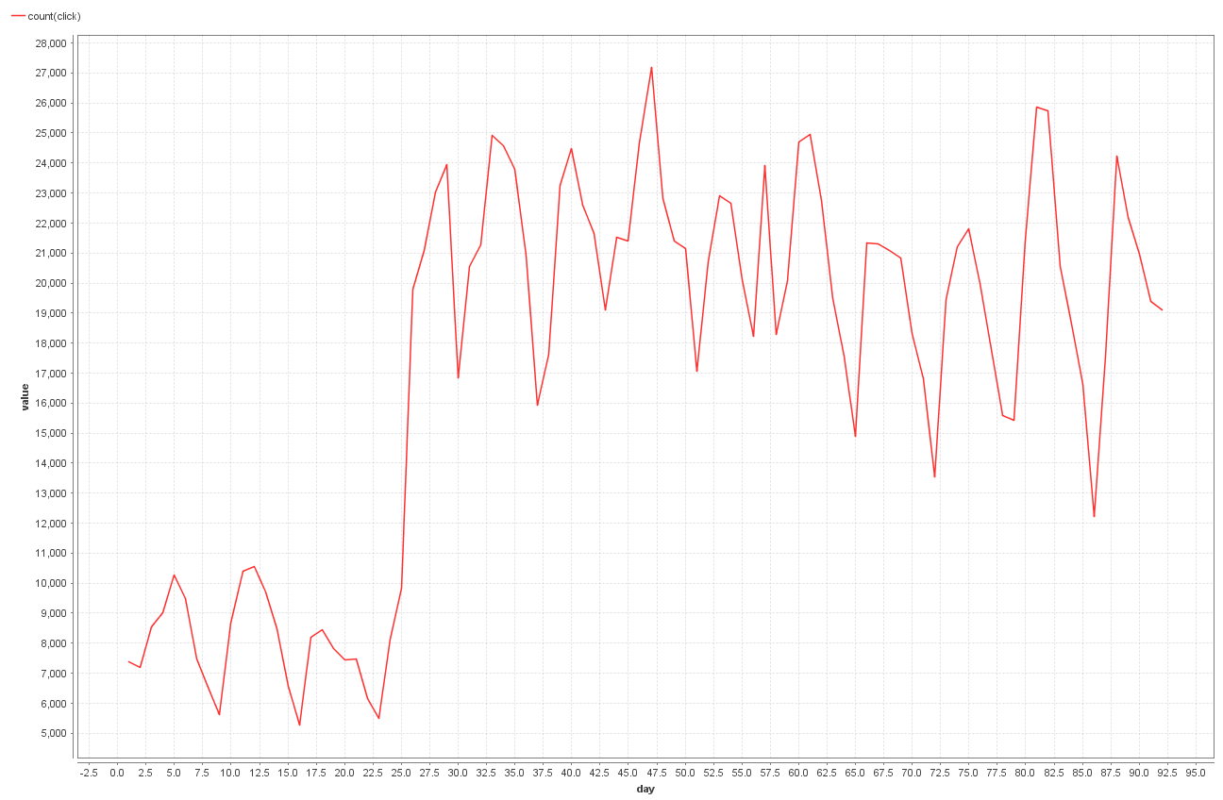
Evaluation of Time Dependent Behavior
Basket actions per day
Order actions per day
Click actions per day
Between day 25 to 26 there is a steep increase (+ 10,000) of clicks
Might be a sign for incomplete data in the first month

Slide 9
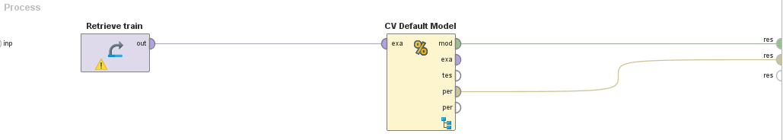
Baseline
Performance of the Default Model
Median: RMSE* = 10.904
Average: RMSE = 10.238
For comparison, basic Gradient Boosted Tree: RMSE = 9.679
*RMSE : Root Mean Squared Error

Slide 10
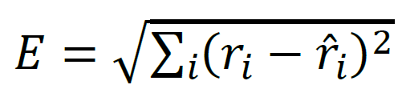
Performance Measurement
Evaluation takes place on example level
Difference between actual value and prediction is squared
Crucial to predict
high revenue transactions correctly
High quantity with decent price
High price
Medium high quantity with medium high price
highly frequent transactions correctly
i.e. no revenue flags

Slide 11
Questions?
Feel free to ask!

